Slide 1

Cloud Architecture

Slide 2
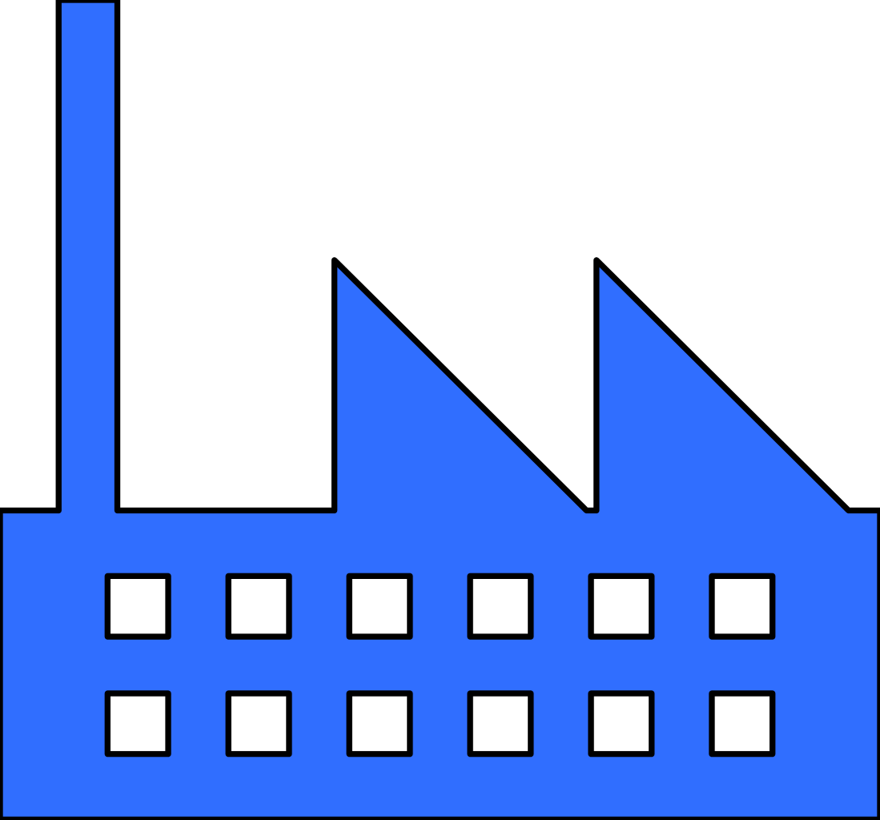




Azure
Cloud
Table Storage
Datatera Inspector
Functions
New Data trigger the C2D flow
Datatera
C2D flow
API
New dataset triggers the flow
Sensitive Data Inspector
Qualitative Data Inspector
Algorithm
Scanner
New buy triggers the flow
Datatera
C2D Computing
Blob
Storage
Datatera Marketplace
Shell
Storage
Block
chain

Slide 3
Datatera
C2D Computing
Pod
Aquarius
Aquarius Rinkeby
ElasticSearch - Master
Provider
Service
Aquarius : 5000
Aquarius Rinkeby : 5001
ElasticSearch - Master : 9200/9300 x3
Provider : 8030

Slide 4
Datatera
C2D flow
API
x

Slide 5
Datatera Inspector
x

Slide 6
THANK YOU

